Slide 1


Final Assessment excel Ananthalakshmi P

Slide 2
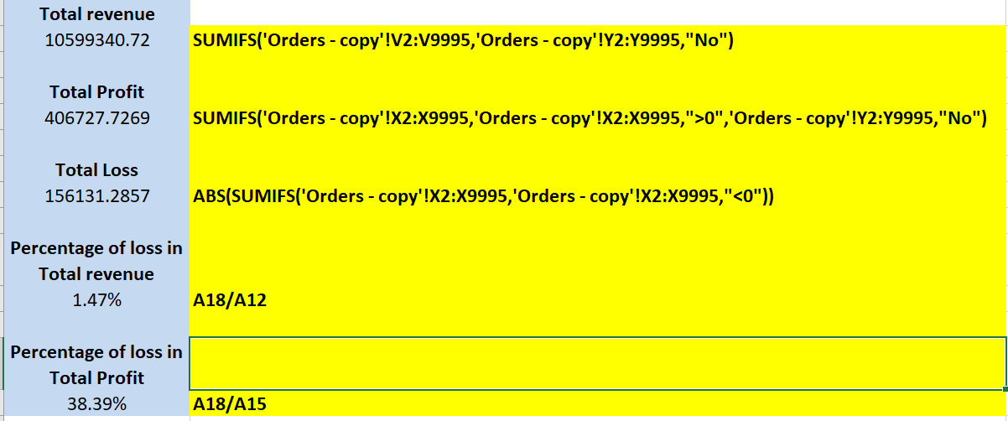
Q1
Insights –
The number of orders returned indicates the extent of dissatisfaction or issues faced by customers with the products or services offered. It reflects on product quality, accuracy in fulfilling orders, and customer service effectiveness.

Slide 3
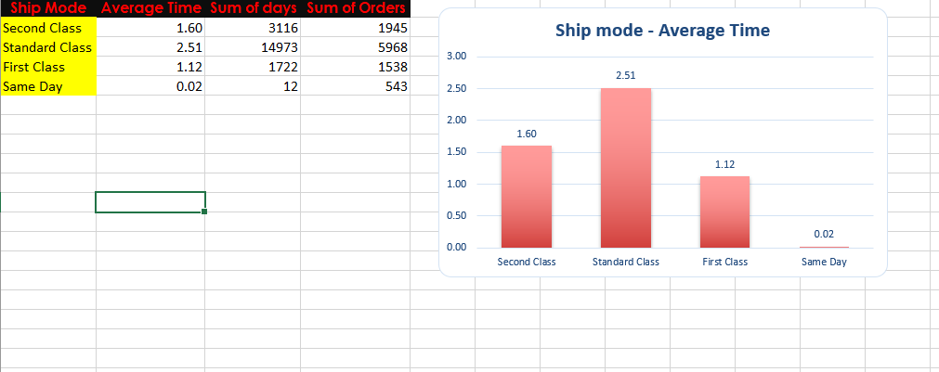
Q2
Insights-
Calculating the average shipping time for each shipping mode allows businesses to understand the typical turnaround time from order placement to shipment.

Slide 4
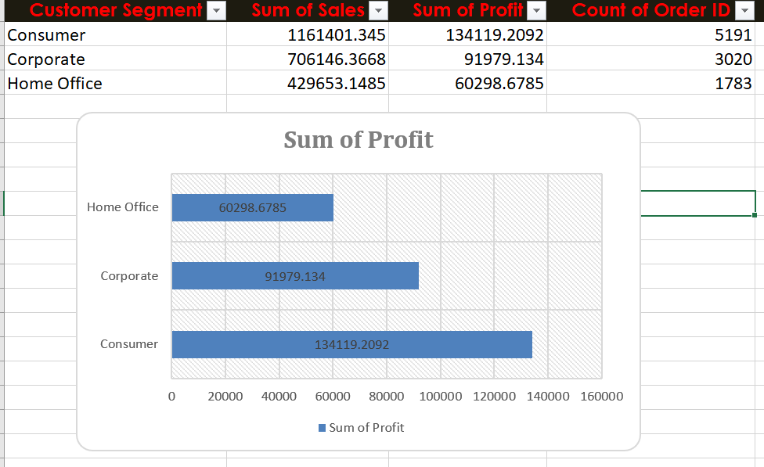
Q3
Insights-
Segmenting customers based on factors such as total sales, frequency of orders, average order value, or product preferences helps identify distinct groups with similar buying patterns.

Slide 5
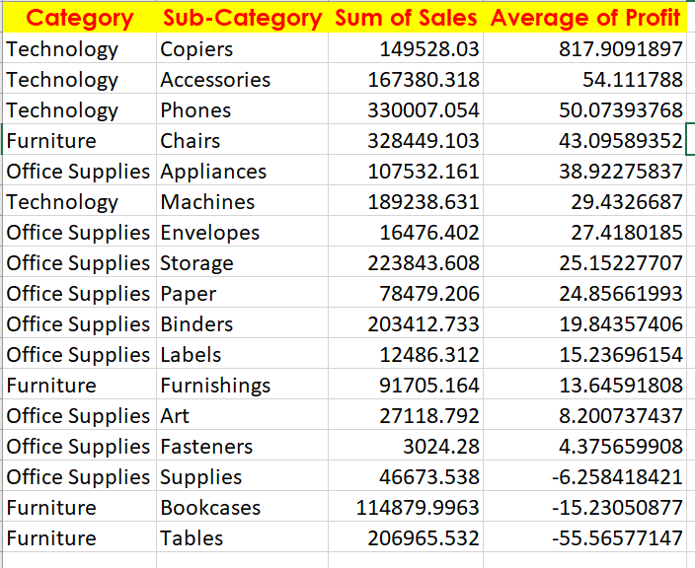
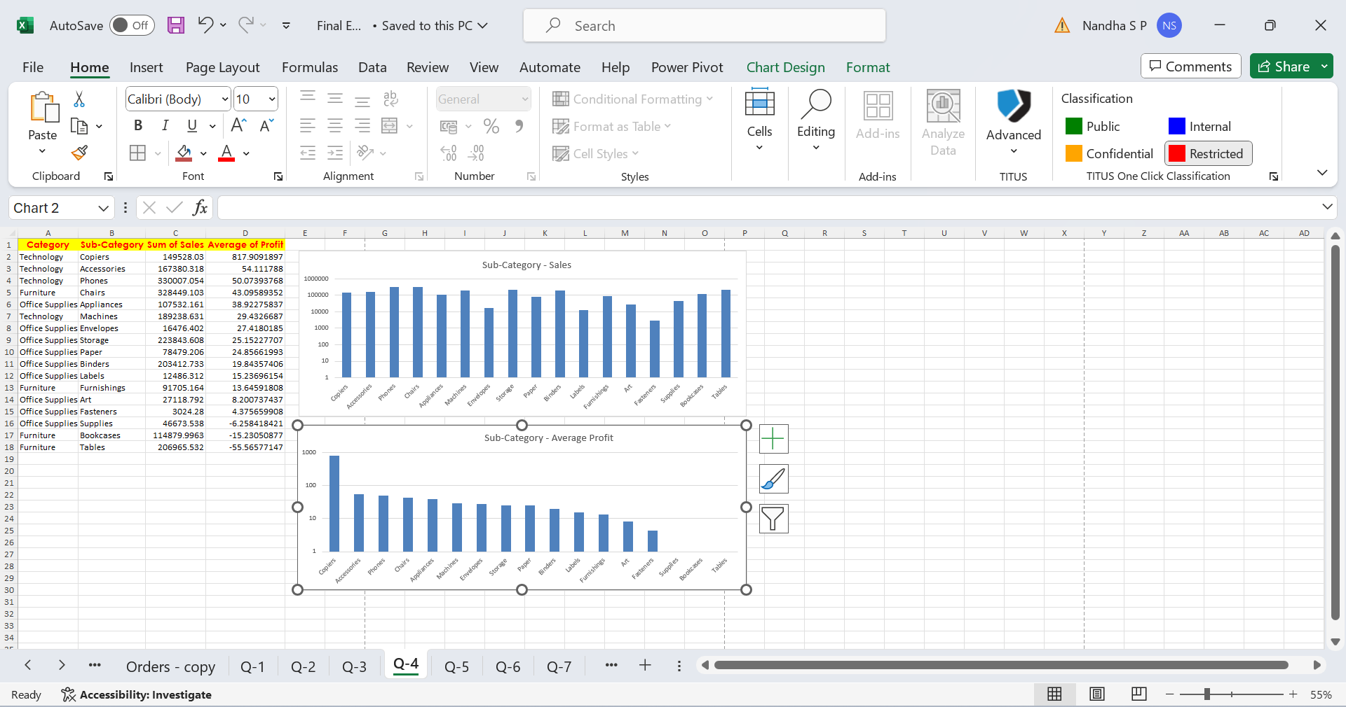
Q4
Insights –
When cost and pricing variances are taken into consideration, the average profit margin offers valuable information about the profitability of products within each category and subcategory.

Slide 6
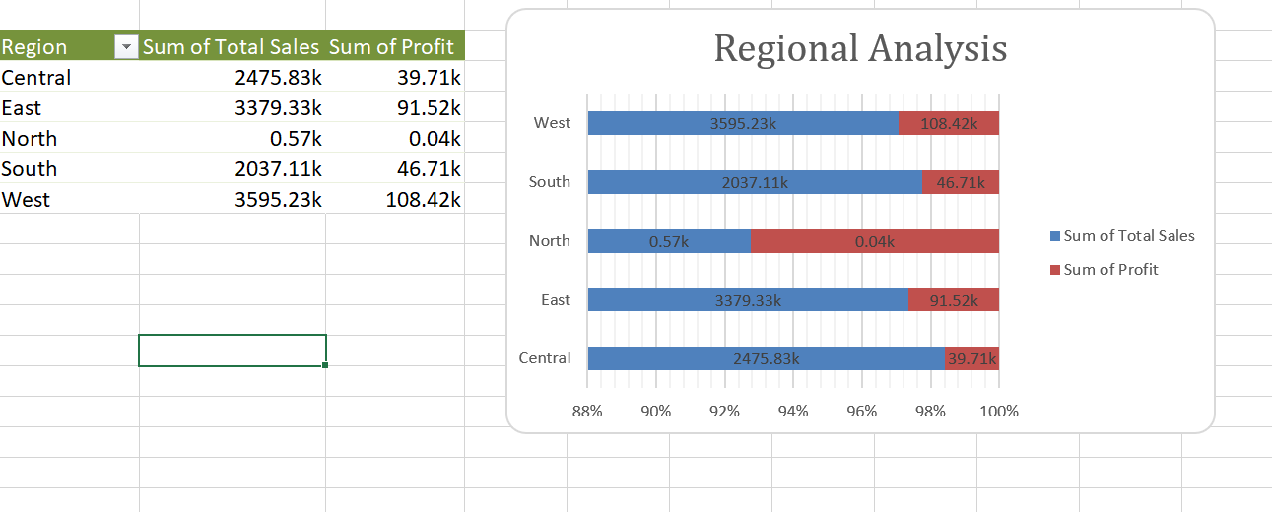
Q5
The top and lowest sales regions can be determined by comparing sales performance across regions. Understanding regional differences in market potential and demand is aided by this comparison.
Insights-
Compare sales performance across regions to identify regions with the highest and lowest sales. This comparison helps understand geographic variations in demand and market potential.

Slide 7
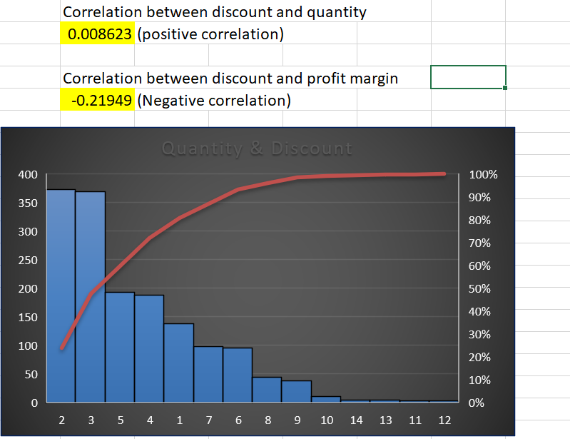
Q6
Insights
Understanding the relationship between discounts and sales volume can be gained by calculating the correlation between the discount rate and the amount sold. better discounts may be linked to better sales, according to a positive connection, whereas the opposite may be true according to a negative correlation.

Slide 8
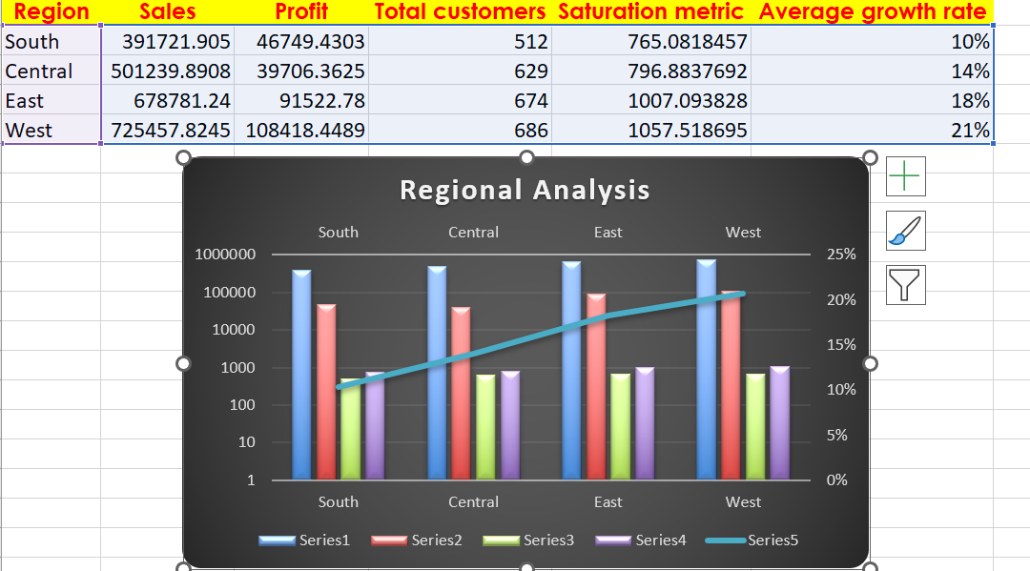
Q7
Insights
Conduct market research to identify regions where your products or services are underrepresented or where there is a growing demand for similar offerings.
Analyze demographic data, economic indicators, consumer behavior, and competitive landscape to assess market potential and identify regions with low market saturation and high growth potential.

Slide 9
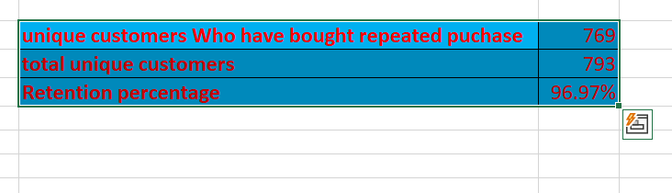
Q8
Insights
Analyzing repeat orders from existing customers allows businesses to calculate the customer retention rate, which represents the percentage of customers who continue to make purchases over time.

Slide 10
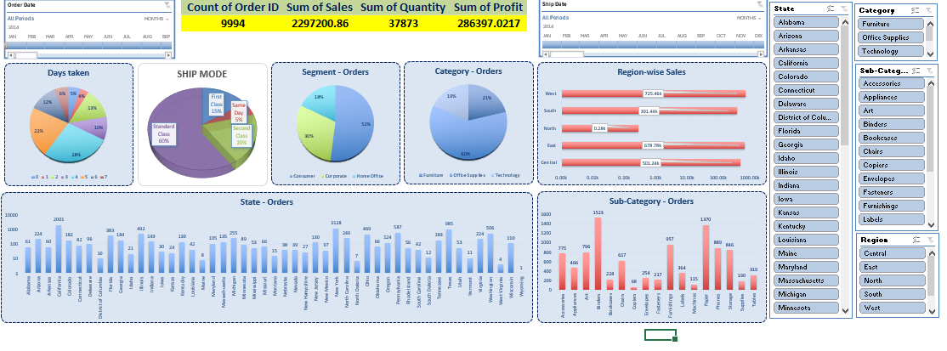
Q9

